Slide 1
Towards I/O Performance Optimizations for Big Data
Shuibing He (何 水 兵)
School of Computer Science, Wuhan University
Notes:
1

Slide 2

My Research Interests
File and storage system
High performance computing system
Cloud computing
Big data processing

Slide 3
Agenda
What we have done
Ongoing work
Research prospect

Slide 4

The Surge of Big Data
Applications become data-intensive from computing-intensive.

Slide 5
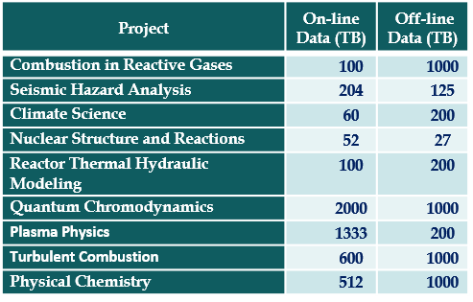
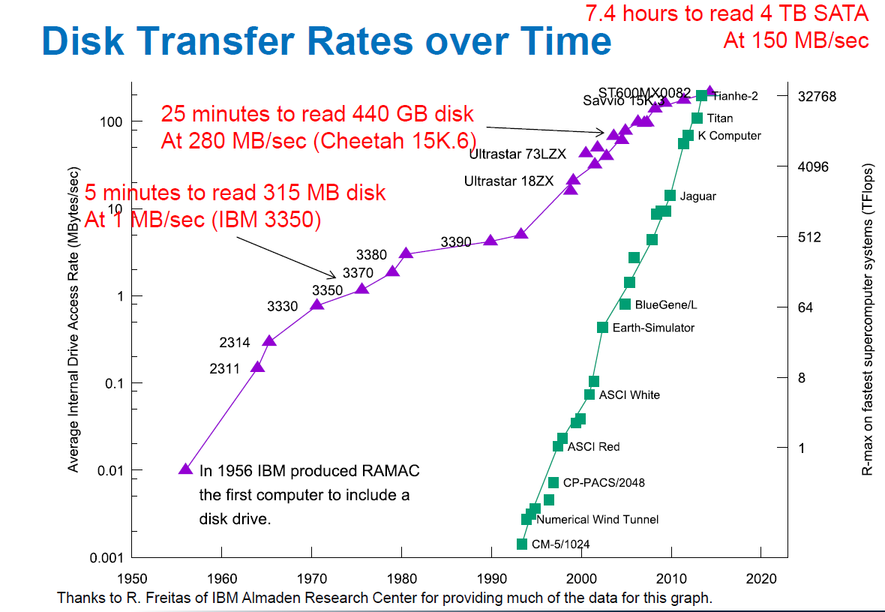

I/O is a Bottleneck
Data requirements for select 2014 INCITE applications at Argonne Leadership Computing Facility (BG/Q) of ANL [1]
[1] R. Latham, R. Ross, B. Welch, and K. Antypas, "Parallel I/O in Practice," Tutorial of the International Conference for High Performance Computing, Networking, Storage and Analysis, 2015

Slide 6
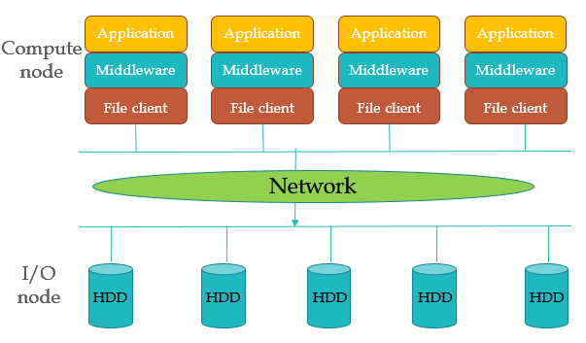





Existing Solution
File server
File server
File server
File server
File server
Architecture of a typical parallel I/O system
However, PFS fails to perform well for certain patterns.

Slide 7
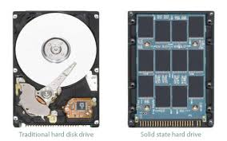
New Storage Media
Solid State Disks
Nand Flash
NVM
PCM, STT-RAM, ReRAM, 3D XPoint technology…
However, a PFS with pure SSDs may be expensive.

Slide 8
Hybrid Parallel I/O Systems
PFS Clients
Network
PFS Servers
HDD
HDD
HDD
HDD
SSD
SSD
HServers
SServers

Slide 9

Critical Challenges
Complex patterns
Heterogeneous servers
Applications
How to improve I/O performance?
Patterns are complex
Parallel I/O Systems
Servers are heterogeneous
Storage Servers

Slide 10
Our Work
Data-intensive Applications
Publications
I/O access tracing
I/O Pattern Analysis
CLUSTER13
I/O Workload
ICDCS14
TPDS1602
TPDS1702
High Performance I/O System
System Architecture
IJHPCA16
TPDS1601
IPDPS15
ICPP15
TC1801
ICA3PP14
DISCS14
TC1702
IPDPS18
Data Layout
Request Scheduling
HiPC15
ICDCS16
TC1701
TPDS1701
Design and Evaluation Tool
I/O System Analysis
Evaluation
Metric
System Simulation
HPDIC13
PDSW14

Slide 11
Representative Work
S4D-Cache (ICDCS14/TPDS16.1)
HAS (IPDPS15/TPDS16.2)
MHA (IPDPS18)

Slide 12
(1)S4D-Cache: Smart Selective SSD Cache for Parallel I/O Systems
S. He, X.-H. Sun, and B. Feng, “S4D-Cache: Smart Selective SSD Cache for Parallel I/O Systems,” ICDCS2014.
Notes:
特点
（1）集中式cache: 只需要部署少量高性能SSD，不需要每个节点一个，更灵活
（2）选择性：不cache所有访问，性能关键的请求：cost model, 不是基于传统的时空局部性，二是考虑请求访问的并行性和SSD设备访问的高性能。

Slide 13
Software Structure
Notes:
[1] Data Identifier intercepts every file request issued to DServers, and identifies requests for performance-critical data using a data access cost model
[2] Redirector redirects the selected requests to the high-performance CServers. While selected write requests and cached read requests are redirected to CServers, other write requests and missed read requests are directed to the traditional DServers.
[3] Rebuilder is responsible for flushing the selected write data back to DServers, and fetching the selected read data to CServers.
[4] Besides these components, S4D-Cache relies on two key data structures, namely, CDT (Critical data table) and DMT (Data Mapping table) to select performance critical data and keep track of file data that has been cached in a CServers.

Slide 14
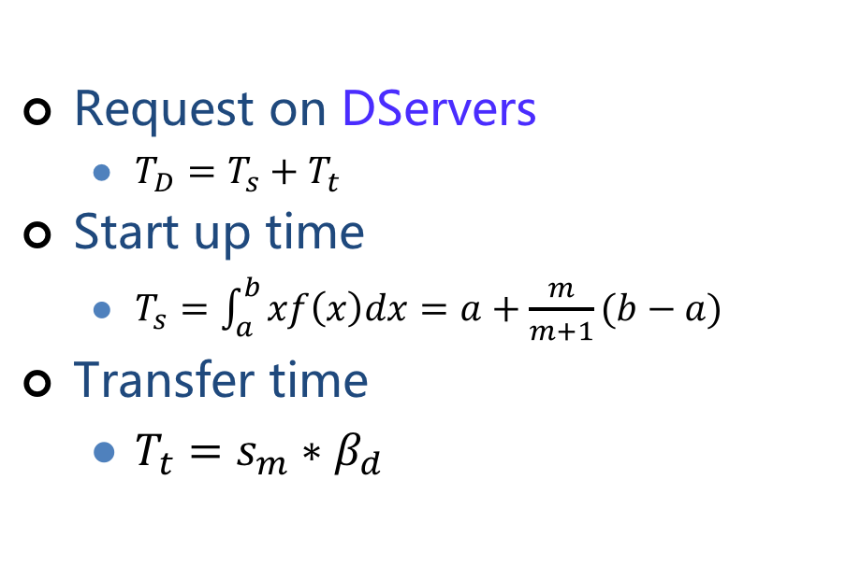
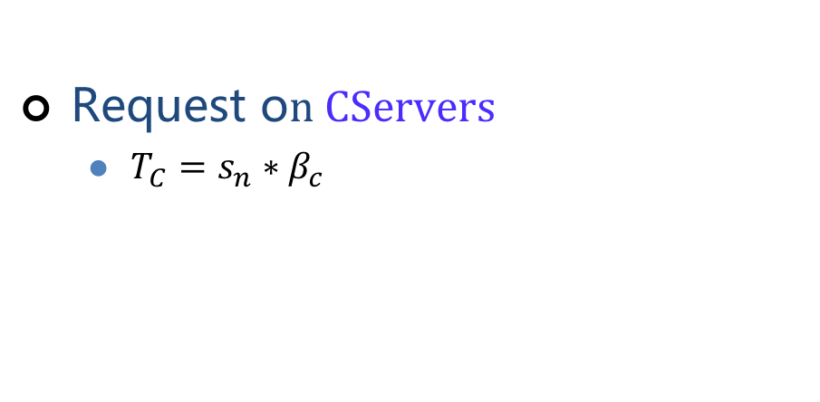
Data Access Cost Model
Request on DServers
$T_{D}=T_{s}+T_{t }$
Start up time
$T_{s}=\int_{a}^{b}{xf\left(x\right)dx=a+\frac{m}{m+1}(b−a)}$
Transfer time
$T_{t}={s_{m}∗β_{d}}_{ }$
Request o$n CServers$
$T_{C}={s_{n}∗β_{c}}_{ }$
Four cases of a file request distribution on servers.
Notes:
[1] H. Huang, W. Hung, and K. G. Shin, "FS2: Dynamic Data Replication in Free Disk Space for Improving Disk Performance and Energy Consumption," in Proceedings of the 20th ACM Symposium on Operating Systems Principles, 2005, pp. 263-276.

Slide 15

Critical Data identification
Performance benefit (B):
A positive B means the request should be served at CServers
Large request should be placed on DServers due to high parallelism
Random small requests should be placed on CServers
$B=T_{D} −T_{C}$

Slide 16
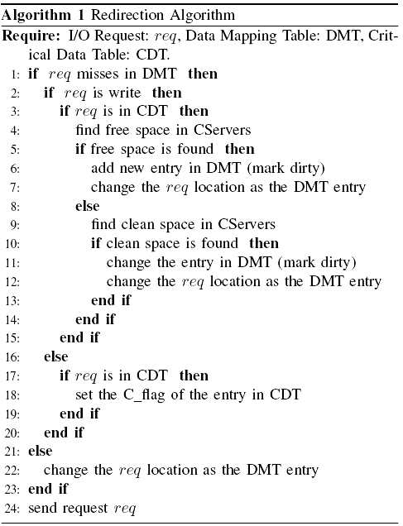
Selective Caching Algorithm
Caching data on CServers based on three factors
The performance benefit (critical data)
Available free space on SServers
Type of I/O requests
Notes:
1. available free space on SServers, indicating whether SServers can accommodate the current region
2. the value of the performance gain of the region, indicating whether I/O performance can be improved if it is placed on SServers
3. the rank of the region performance gain, indicating whether it incurs more performance gains than other regions if it is located on SServers.

Slide 17
Implementation
Environments
I/O middleware MPICH2
PFS: PVFS2
Cache metadata mapping table
Memory: Hash table
Storage file: Berkeley DB file on CServers
I/O redirection module
MPI_File_open/read/write(),…
Rebuilder
Multiple threads
Shared variables for communication between threads

Slide 18
Experimental Setup
 | 65-nodes SUN Fire Linux Cluster
CPU | Quad-Core AMD Opteron(tm) Processor 2376 * 2
Memory | 4 * 2GB, DDR2 333MHz
Network | 1 Gbps Ethernet
Storage | HDD: Seagate SATA II 250GB, 7200RPM SSD: OCZ PCI-E X4 100GB
OS | Linux kernel 2.6.28.10
File system | PVFS2 2.8.2
1: 32 computing nodes, eight HServers, four CServers
2: Stock system w/o S4D-Cache enabled
3: When S4D-Cache is enabled, the cache capacity is set to 20% of the application's data size.

Slide 19
Benchmarks
IOR
10 instances of IOR
six issue sequential I/O requests
remaining send random I/O requests
In each instance, default parameters
Access a shared 2GB file
32 processes
request size is kept to 16KB
HPIO
MPI-Tile-IO

Slide 20
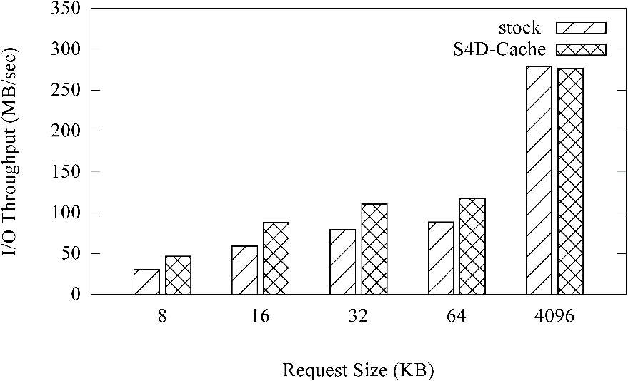
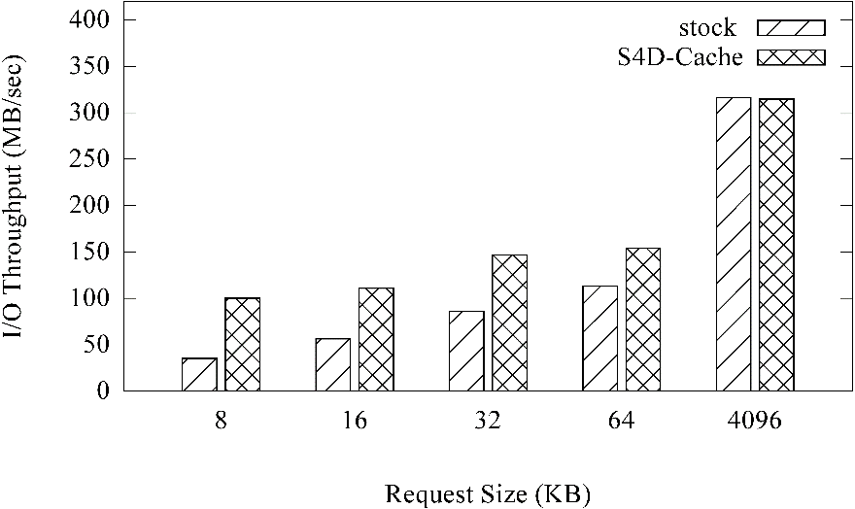
Varying Request Sizes
Write
Read
For small requests, S4D-Cache significantly improve the I/O performance
For large requests, less performance gains can be obtained
Reads have similar trend as writes

Slide 21
Selective vs. Non-selective
Table. Performance comparison of selective (S4D-Cache) and non-selective caching scheme.
Request Size | Selective(MB/s) | Non-selective(MB/s)
8KB | 60.6 | 56.1
64KB | 136.1 | 127.3
512KB | 230.9 | 21.4
4KB | 325.2 | 293.5
Our selective cache admission policy is more efficient than traditional non-selective policy

Slide 22
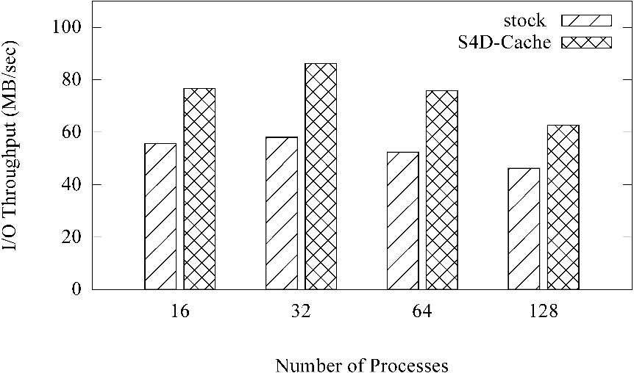
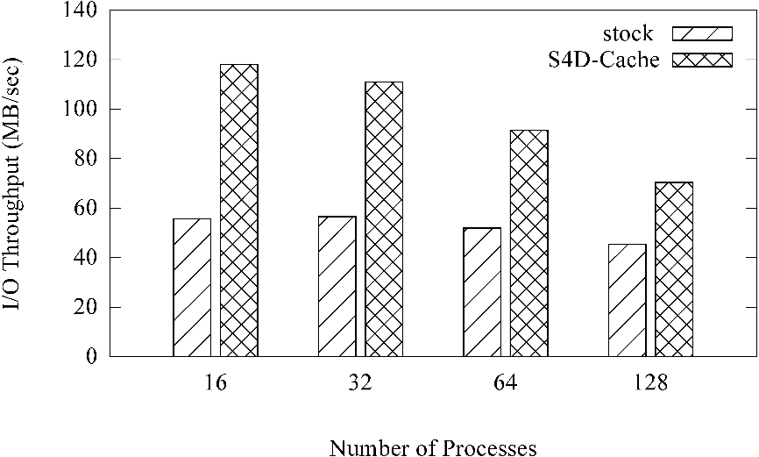
Varying Numbers of Processes
Write
Read
S4D-Cache improves the overall I/O bandwidth for various processes
With the number of processes increasing, bandwidth gets lower because each CServer needs to serve more processes, leading to severe I/O contention
Good scalability in terms of the number of processes

Slide 23
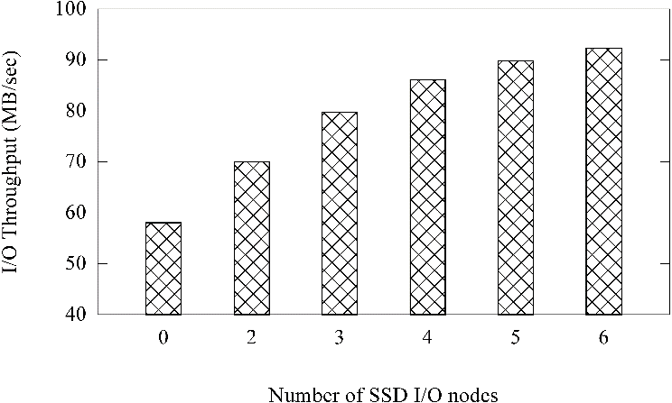
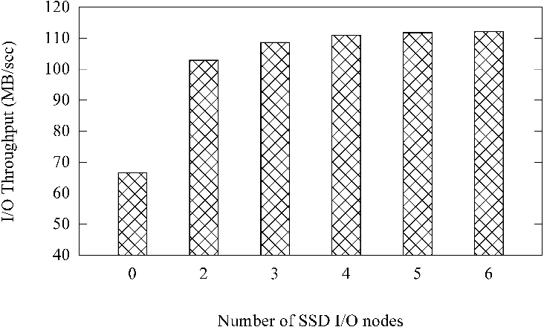
Varying Numbers of SSD Nodes Servers
Write
Read
With the number of CServers increasing, the I/O bandwidth improves because CServers provides better random performance.
The I/O performance only slightly improves when the is above four, because only a portion of requests are random and the improvement is bounded to them.

Slide 24
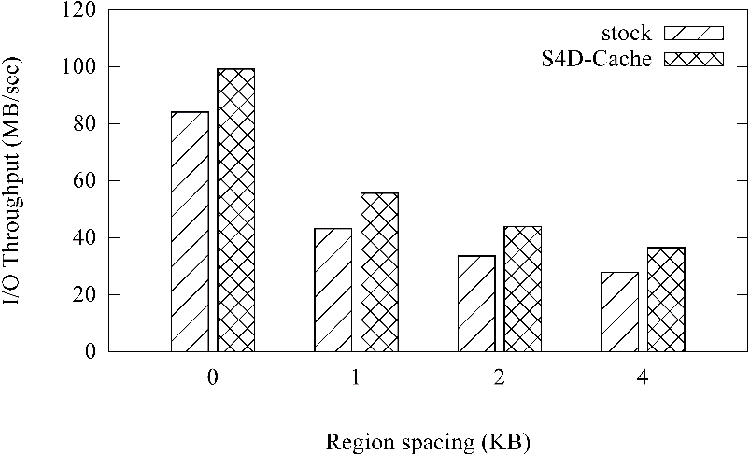
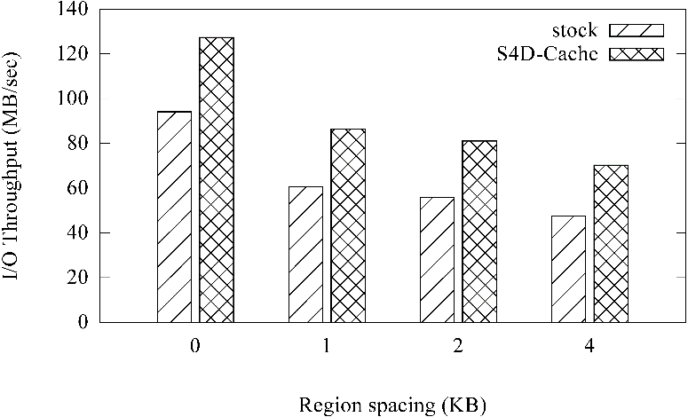
HPIO
Write
Read
S4D-Cache is effective with respect to HPIO benchmark
Improvements for HPIO are not as significant as those for IOR because the workload is not as random as IOR

Slide 25
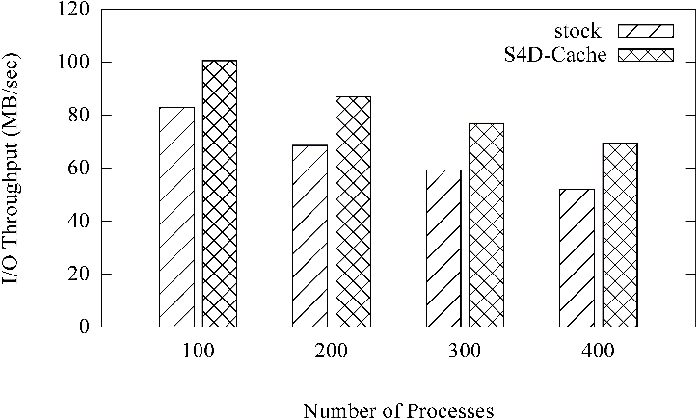
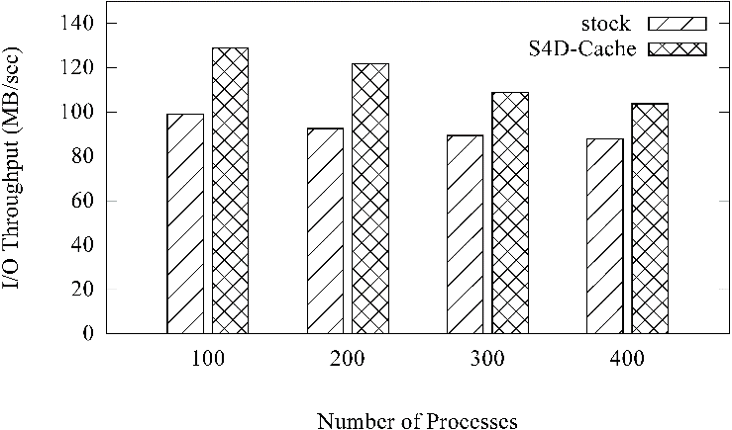
MPI-Tile-IO
Write
Read
Performance improvement is still significant

Slide 26
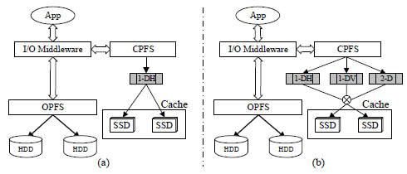
S4D-Cache Extension: SLA-Cache
(a): Current cache systems are layout-oblivious to
place cache data. (b) The cache data placement in SLA-Cache.
S. He, Y. Wang, and X.-H. Sun, "Improving Performance of Parallel I/O Systems through Selective and Layout-Aware SSD Cache," IEEE TPDS, vol. 27, pp. 2940-2952, 2016.

Slide 27
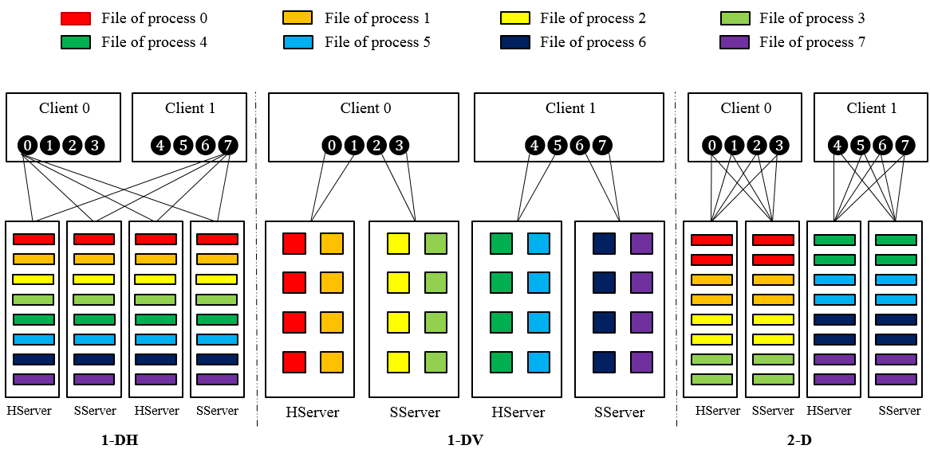
(2)HAS: Heterogeneity-Aware Selective Layout Scheme
Three typical data layout schemes
S. He, X.-H. Sun, and A. Haider, "HAS: Heterogeneity-Aware Selective Data Layout Scheme for Parallel File Systems on Hybrid Servers," IPDPS2015.
Notes:
另外一种场景是SSD充当持久存储（平面存储），[1]To obtain optimal performance for different I/O access patterns, PFSs, such as OrangeFS, Lustre and GPFS, support three typical data layout policies
---性能相当时发生。
one-dimensional horizontal (1-DH), one-dimensional vertical (1-DV), and two-dimensional (2-D) layout.
[2] 1-DH is the simple striping method that distributes a process's file across all available servers in a round-robin fashion.
1-DV performs no striping at all, and instead places the file data on one server. 2-D is a hybrid method, it distributes the file on a subset of servers.
All three layout policies utilize fixed-size file stripes to distribute file data, and each of them work well for a particular kind of I/O access patterns.
[3] However, these schemes are designed for homogeneous PFSs on identical file servers

Slide 28
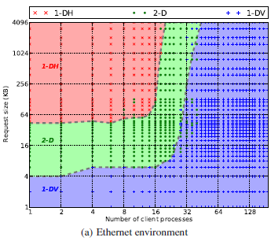
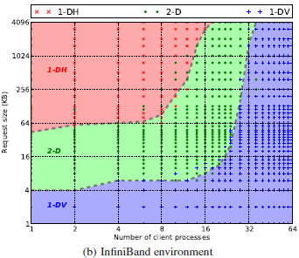
Layout and Application Performance
Different Layouts favor different patterns
H. Song, Y. Yin, Y. Chen, and X.-H. Sun, "A Cost-Intelligent Application-Specific Data Layout Scheme for Parallel File Systems," HPDC2011.

Slide 29
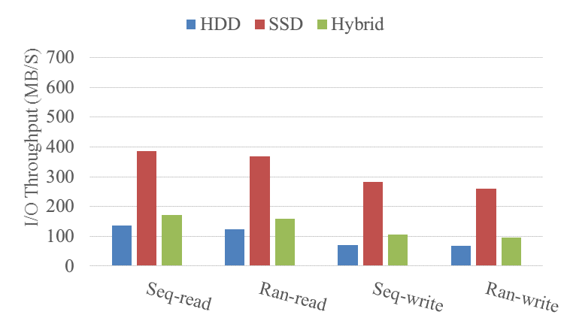
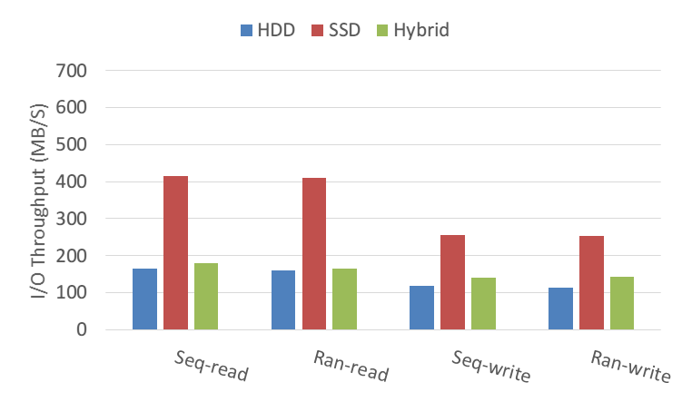
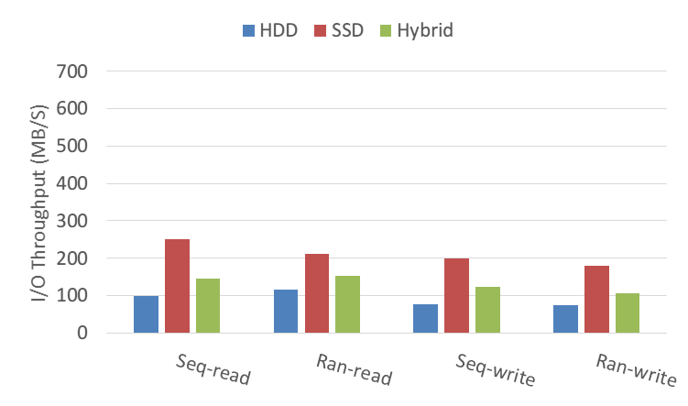

Motivation Example
Three server configurations
4HDD, 4SSD, 4HDDs+4SSDs (Hybrid)
1-DH
1-DV
2-D
Existing solution is inefficient for hybrid cluster:
Hybrid slightly outperforms the HDD configuration!
Hybrid performs worse than the SSD configuration!

Slide 30
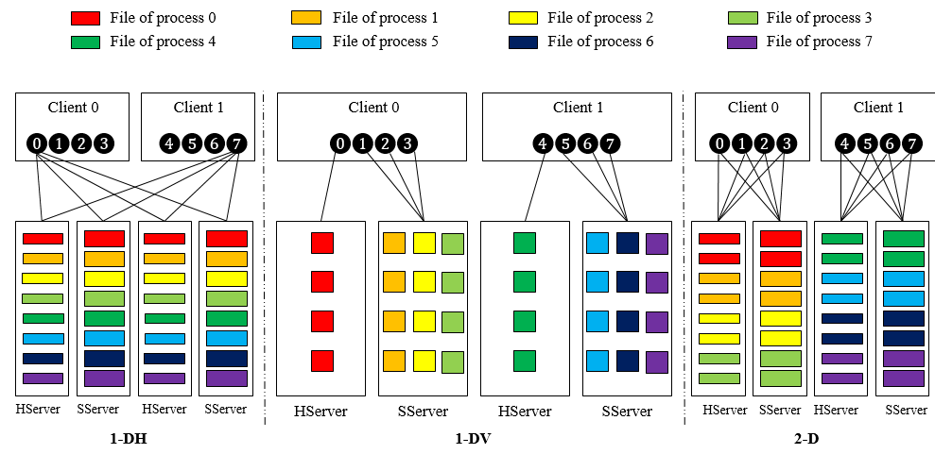
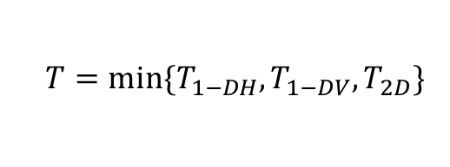
HAS Idea
Obtain the optimized layouts for the three policies
Selects the candidate with the lowest cost to distribute data
$$T=min⁡\{T_{1−DH},T_{1−DV},T_{2D}\}$$
Notes:
（1）选择性的在三种布局方式中选择最优放置方式
（2）对于每种放置方式，转换为线性优化问题求解分条大小和放置文件个数

Slide 31
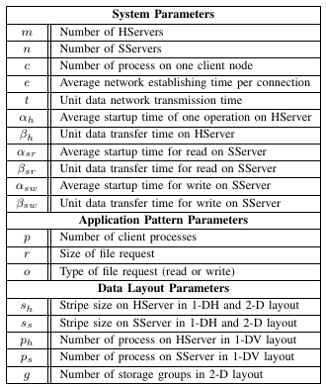
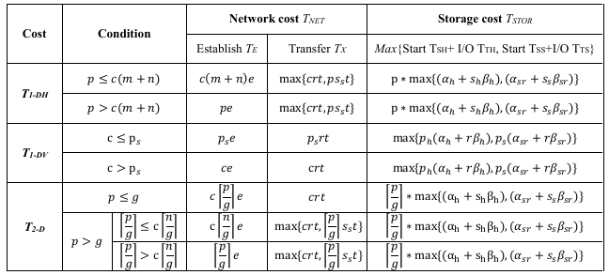
Challenge 1: Data Access Model
The cost is defined as the overall I/O time of a data access
Consider the system, application, and layout characteristics
Table 2. Cost formulas
Notes:
Since SServers and HServers have distinct storage media, they shows different storage characteristics.
[1]First, Ts for SServer is much smaller than for HServers.
[2]Second, β_s is several times smaller than β_h, which means SServers have a performance advantage over HServers for large requests, but not as significant for small requests.
[3]Finally, write performance of SServer is lower than read performance because write operations on SSDs lead to numerous background activities, including garbage collection and wear leveling.

Slide 32
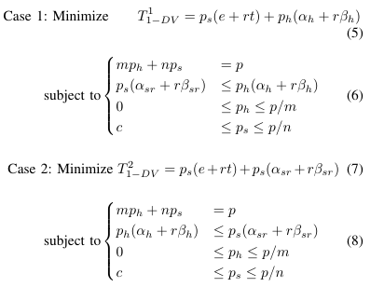
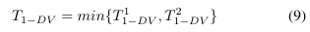
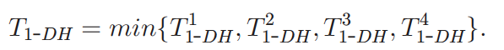
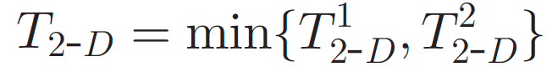
Challenge 2: Layout Optimization
1-DV optimization
Translated into linear programming (LP) problems
1-DH and 2-D are similar
Notes:
[1]The system and pattern related parameters can be regarded as constants, and T_{1-DV} is a function of two unknowns---p_h and p_s. The final problem is to choose the values of p_h and p_s to minimize T_{1-DV}.
[2]According to the member values in the corresponding maximum expressions in the cost formulas, we translate this optimization problem into two linear programming (LP) problems as shown in case (1) and (2).
[3] The final cost for {1-DV} determined by the minimum of the two cases.

Slide 33
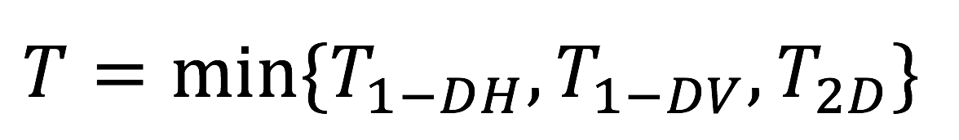
Implementation of HAS
HAS data layout optimization procedure
Notes:
[1]We implemented HAS in OrangeFS, which is a popular parallel file system and directly provides the varied-size striping method for each file server.
[2]The procedure of the HAS scheme includes the following three phases, as shown in Figure 5.

Slide 34
Experimental Setup
 | 65-nodes SUN Fire Linux Cluster
CPU | Quad-Core AMD Opteron(tm) Processor 2376 * 2
Memory | 4 * 2GB, DDR2 333MHz
Network | 1 Gbps Ethernet
Storage | HDD: Seagate SATA II 250GB, 7200RPM SSD: OCZ PCI-E X4 100GB
OS | Linux kernel 2.6.28.10
File system | OrangeFS 2.8.6
Nodes
Eight computing nodes, four HServers, four SServers
Data placement schemes
Application-aware Data Layout scheme (ADL), Storage-aware Data Layout scheme (SDL), and the proposed scheme (HAS)
Benchmarks: IOR and BTIO

Slide 35
Different Types of I/O Modes
Read
Write
HAS improves read performance up to 189.7% over ADL with all I/O access patterns, and write performance up to 242.7%.
Compared with SDL, HAS improves the performance up to 23.8% for reads and 21.1% for writes.
SDL is better than ADL because the storage heterogeneity is the main factors degrading I/O performance.
HAS’s read performance exceeds its write performance because SSDs performs better for read operations than write
Notes:
Request size of 512 KB
Processes: 32

Slide 36
Different Numbers of Processes
Read
Write
HAS has the best performance among the three schemes.
For 16 processes, HAS uses 1-DH, is the same as SDL; for large number of processes, HAS uses 1-DV policy, providing better performance than 1-DH used by SDL.
As the number of processes increase, the performance decreases because more processes lead to server I/O contention in HServers and SServers.
HAS has high scalability with the number of processes.

Slide 37



(3) MHA: Migratory Heterogeneity-Aware Data Layout
Region
Region
(a)Fixed-size stripe data layout
(b) HARL data layout
HARL is sub-optimal for
heterogeneous pattern!
S. He, X.-H. Sun, Y. Wang, A. Kougkas, and A. Haider, "A Heterogeneity-Aware Region-Level Data Layout Scheme for Hybrid Parallel File Systems," ICPP2015.

Slide 38
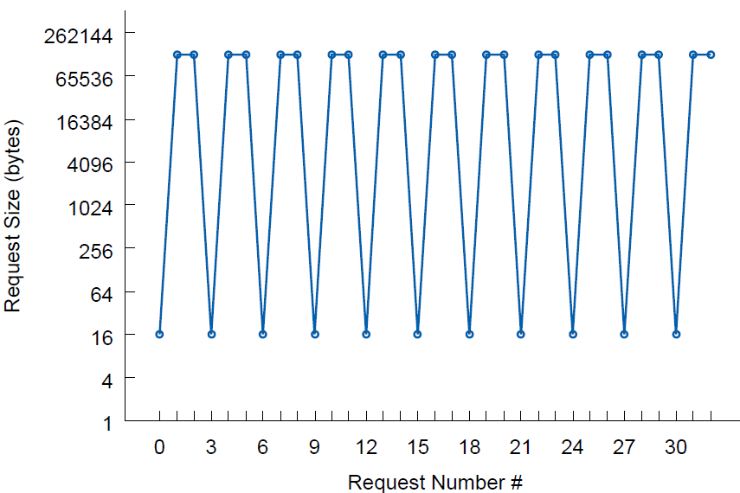
Motivation and Solution of MHA
Data access sequence in a loop of LANL application
MHA data layout
S. He, X.-H. Sun, Y. Wang, and C. Xu, "A Migratory Heterogeneity-Aware
Data Layout Scheme for Parallel File Systems," in IPDPS, CCF B, 2018.

Slide 39
Selected Publications (1/2)
S. He and X.-H. Sun, “A Cost-Effective Distribution-Aware Data Replication Scheme for Parallel I/O Systems,”TC, 2018.
S. He, Y. Wang, X.-H. Sun, and C. Xu, "Using MinMax-Memory Claims to Improve In-Memory Workflow Computations in the Cloud," TPDS, 2017.
S. He, Y. Wang, Z. Li, X.-H. Sun, and C. Xu, "Cost-Aware Region-Level Data Placement in Multi-Tiered Parallel I/O Systems," TPDS, 2017.
S. He, Y. Wang, X.-H. Sun, and C. Xu, “Heterogeneity-Aware Collective I/O for Parallel I/O Systems with Hybrid HDD/SSD Servers,” TC, 2017.
S. He, Y. Wang, X.-H. Sun, and C. Xu, “HARL: Optimizing Parallel File Systems with Heterogeneity-Aware Region-Level Data Layout,” TC, 2017.
S. He, Y. Wang, and X.-H. Sun, "Boosting Parallel File System Performance with Heterogeneity-Aware Selective Data Layout," TPDS, 2016.
S. He, Y. Wang, and X.-H. Sun, "Improving Performance of Parallel I/O Systems through Selective and Layout-Aware SSD Cache," TPDS, 2016.
S. He, X.-H. Sun, Y. Wang, and C. Xu, "A Migratory Heterogeneity-Aware Data Layout Scheme for Parallel File Systems," IPDPS, 2018.

Slide 40
Selected Publications (2/2)
S. He, X.-H. Sun, and A. Haider, “HAS: Heterogeneity-Aware Selective Data Layout Scheme for Parallel File Systems on Hybrid Servers,” IPDPS, 2015.
S. He, X.-H. Sun, Y. Wang, A. Kougkas, and A. Haider, “A Heterogeneity-Aware Region-Level Data Layout Scheme for Hybrid Parallel File Systems,” ICPP, 2015.
S. He, X.-H. Sun, and B. Feng, “S4D-Cache: Smart Selective SSD Cache for Parallel I/O Systems,” ICDCS, 2014.
Y. Wang, S. He, X. Fan, C. Xu, J. D. Horton, and J. C. Culberson, "Data Caching in Next Generation Mobile Cloud Services, Online vs. Off-line," ICPP, 2017.
Y. Wang, B. Veeravalli, C.-K. Tham, S. He, and C. Xu, “On Service Migrations in the Cloud for Mobile Accesses: A Distributed Approach,” TAAS, 2017.
Z. Li and S. He, "Fixed-Priority Scheduling for Two-Phase Mixed-Criticality Systems," TECS, 2017.
Y. Wang, C. Xu, S. He, and X.-H. Sun, "On MinMax-Memory Claims for Scientific Workflows in the In-Memory Cloud Computing," ICDCS, 2016.

Slide 41
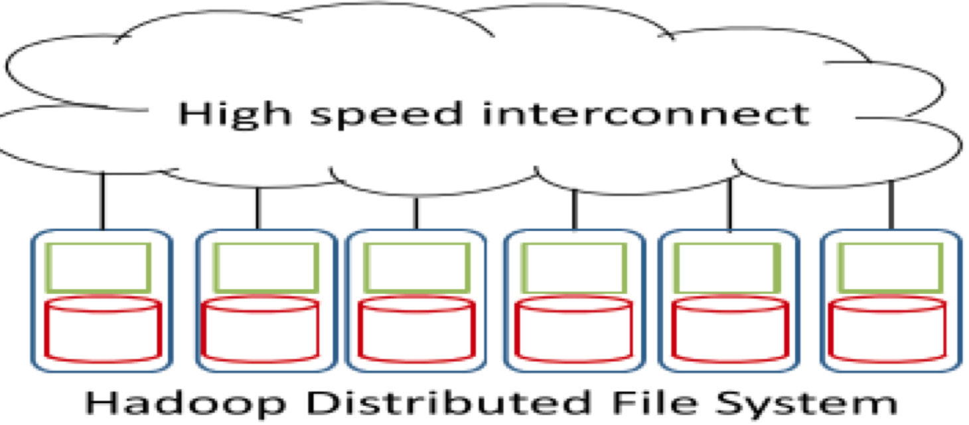
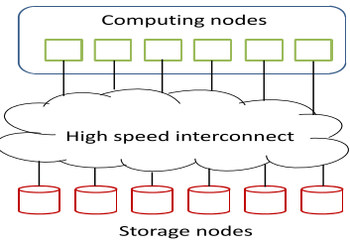
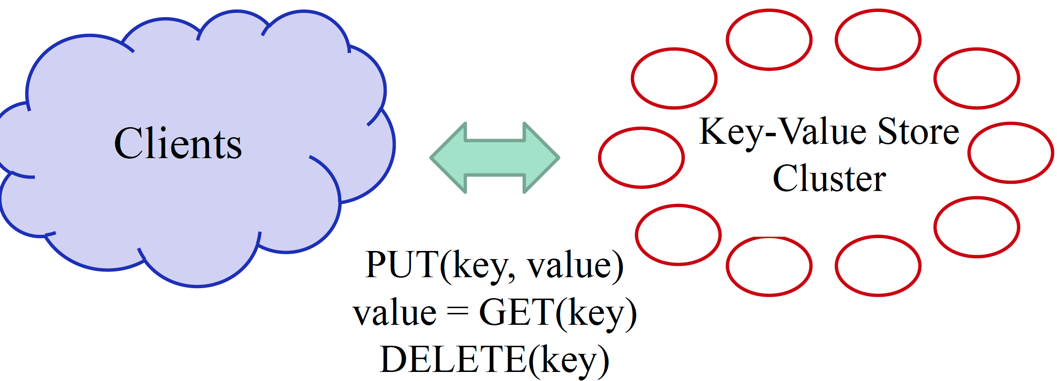
Ongoing Work: Application Changes
Cloud Computing/Big Data Analytics (MapReduce)
High-Performance Computing
A MapReduce/Hadoop Cluster
Database Management
(Key-Value Store)
A HPC Cluster
Notes:
两种计算平台和存储模型；CAP模型，编程模型和存储模型不同。C: 一致性，A: 可用性（数据可访问，不能宕机），P：分区容错性。
两种平台区别：
（1）体系结构上计算和存储不同节点，单一节点；
（2）数据访问局部性，远程访问。
（3）存储访问特征不同：burst访问，小请求，连续大块访问，64MB。
我们已经展开了初步工作，如HiPC, Maris，数据放置和job scheduling, 利用新型存储介质加速
•Dynamo at Amazon
•BigTable (LevelDB) at Google
•Redis at GitHub, Digg, and Blizzard Interactive
•Memcached at Facebook, Zynga and Twitter
•Voldemort at Linkedin

Slide 42
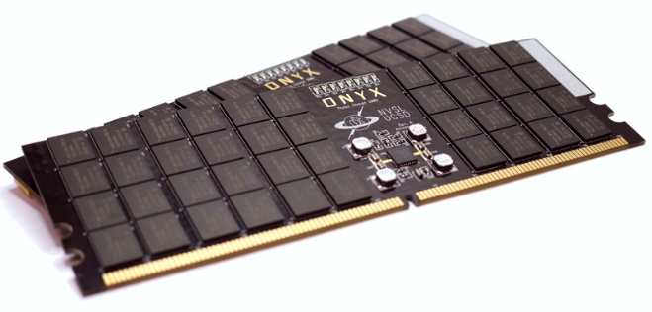

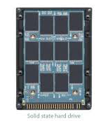



Ongoing Work: Technology Changes
HDD
SSD
NVM

Slide 43
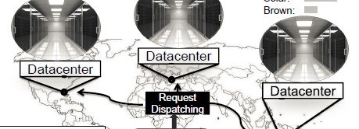



Ongoing Work: MapReduce (1/5)
Performance
Data placement
Job scheduling
Energy
Solar
Wind
Data Centers
Green Energy
Green Energy
Notes:
考虑新型介质的应用；

Slide 44

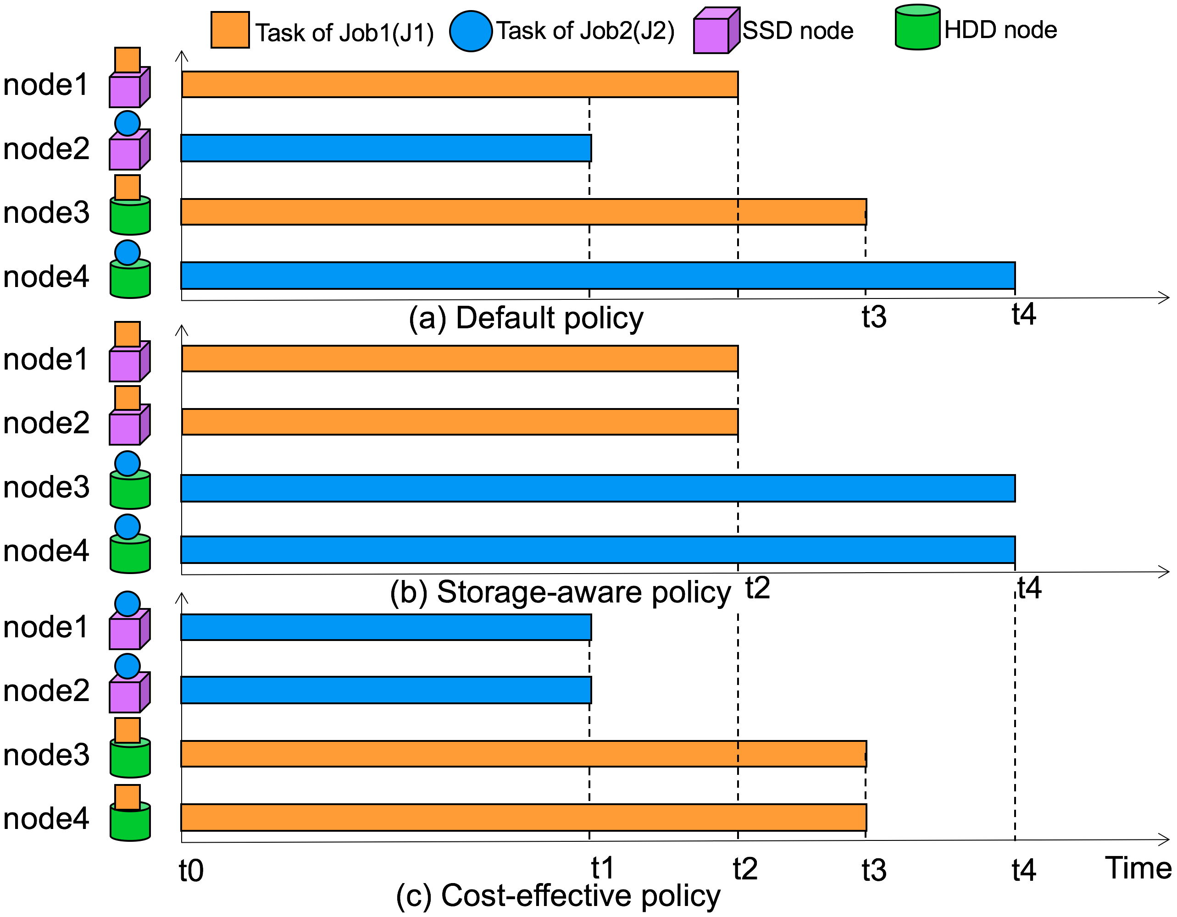
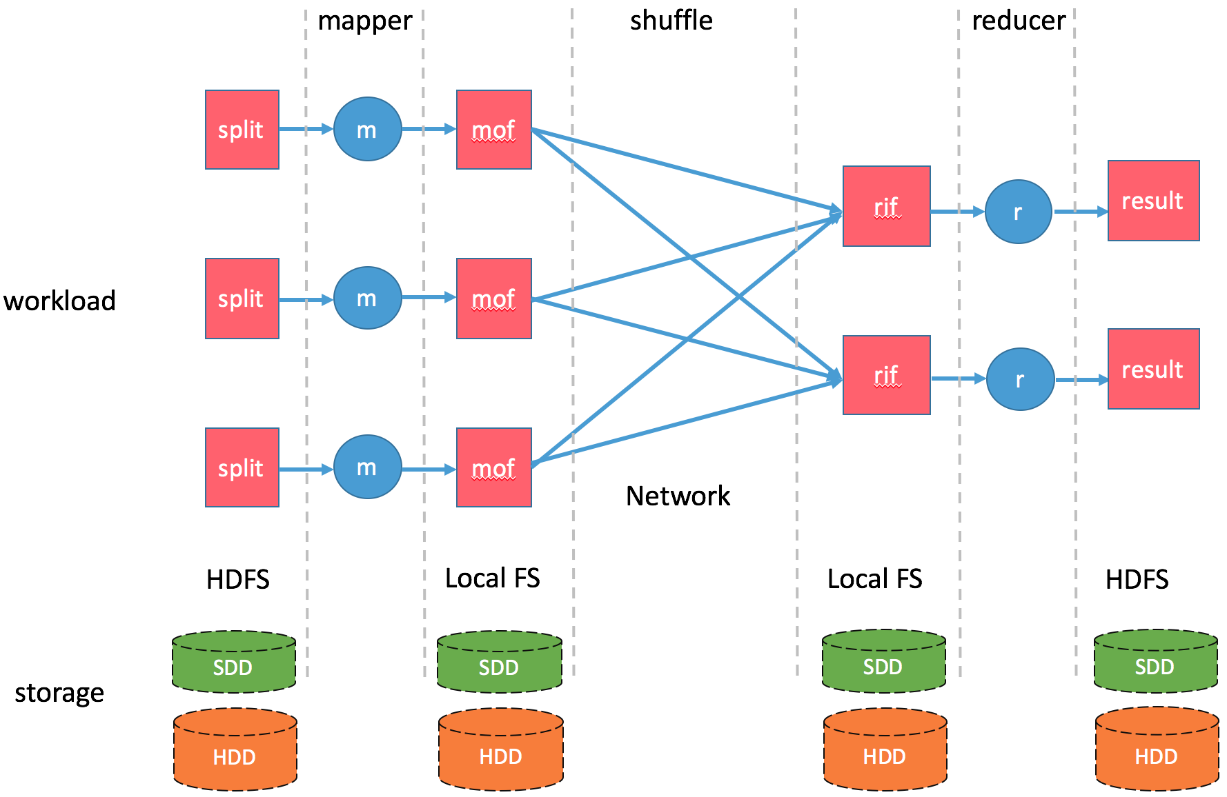
Ongoing Work: MapReduce (1/5)
APPLES: APplication-aware PLacEment and Scheduling for Storage-Heterogeneous Hadoop Clusters
System architecture
Will be submitted to XXX.

Slide 45
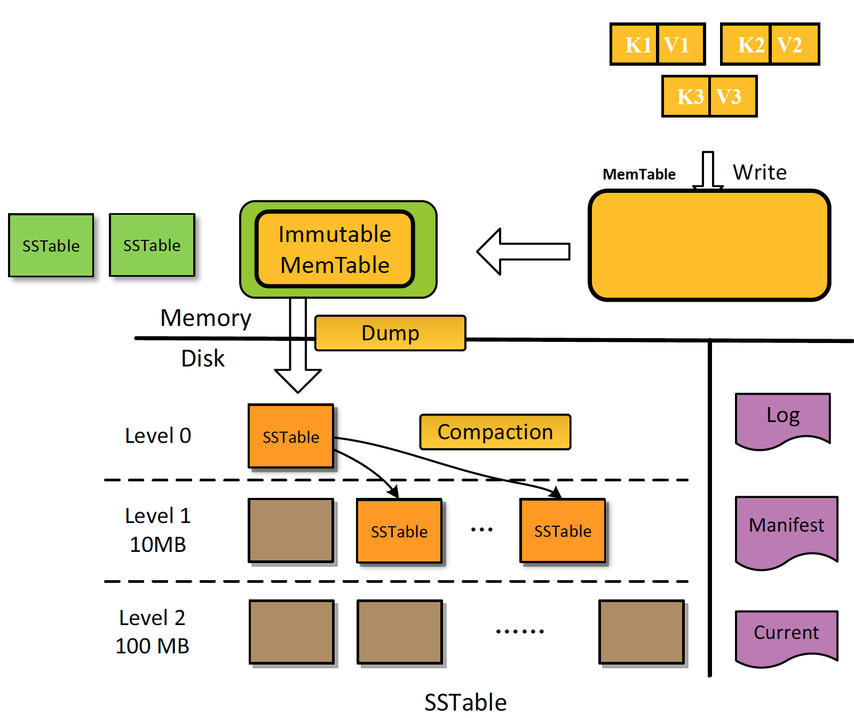
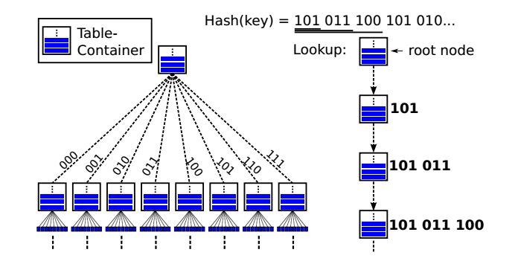
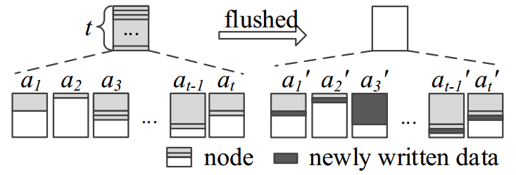

Ongoing Work: Key-Value Store(2/5)
Integrated Appending and Merge Tree (IAM)
(a) LSM tree (Merge)
(b) LSA tree (Append)
Amplification | LSM | LSA | IAM
Low write | ✗ | ✓ | ✓
Low read | ✓ | ✗ | ✓
Low space | ✓ | ✗ | ✓
(c) IAM tree
Under revision to VLDB2018 (CCF A)

Slide 46
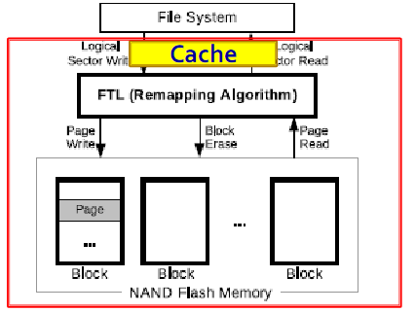

Ongoing Work: SSD and NVM (3/5)
SSD Cache/Buffer Management
SSD实验平台
Under Preparation for USENIX FAST2019 (CCF A)

Slide 47
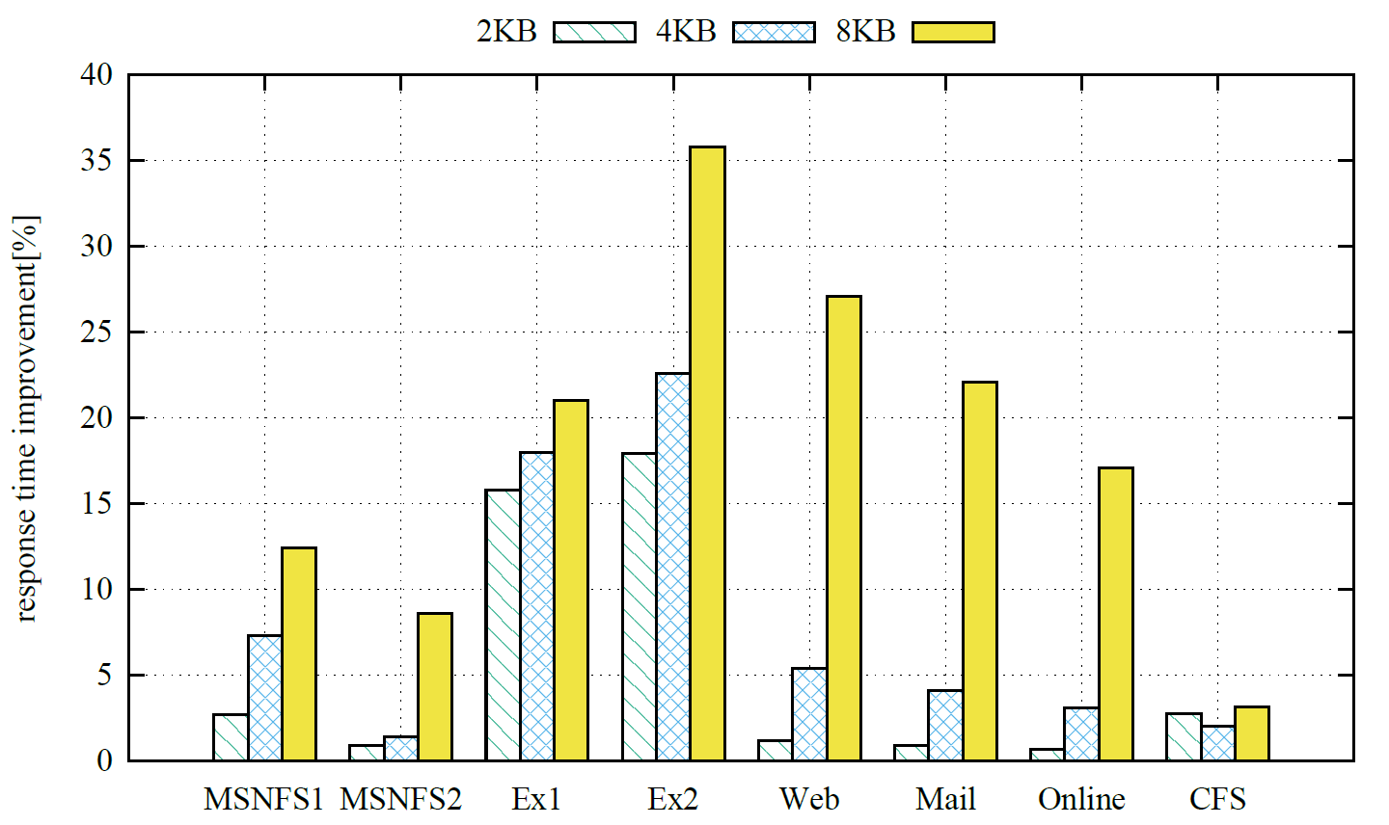
Result: Our scheme vs. LRU
Average request response time improvement compared to LRU under different page sizes.

Slide 48
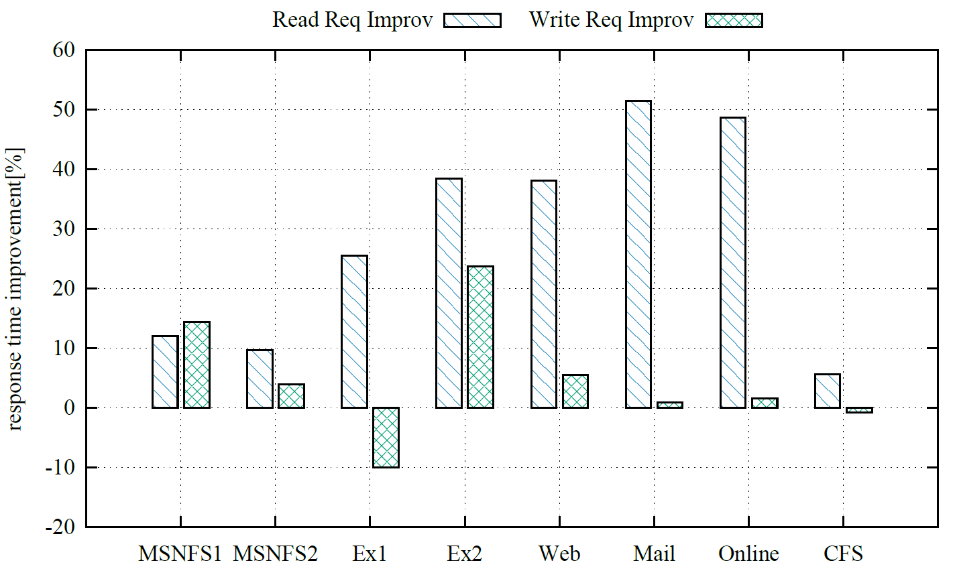
Read and Write Improvement
Read and write performance improvement.

Slide 49
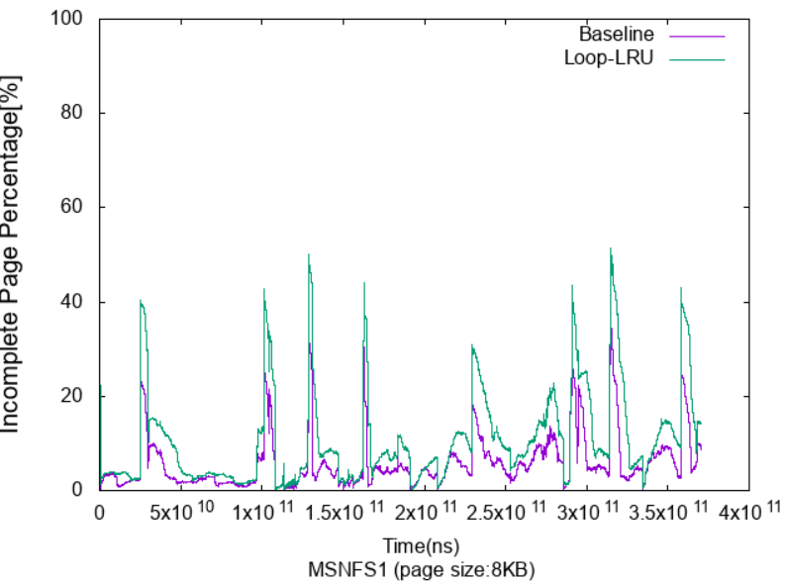
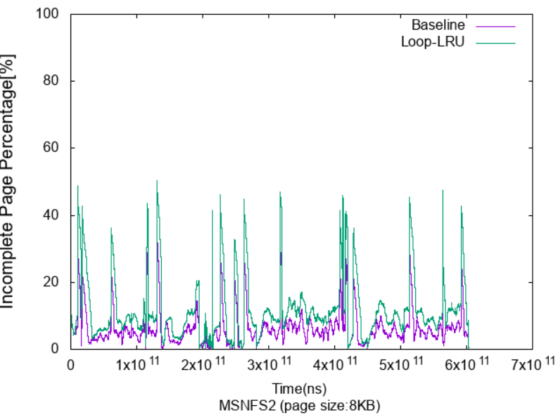






Non-Complete Page Ratio in the Buffer
Our scheme keeps more non-complete pages in the buffer to reduce replacement costs.

Slide 50








CDF of Request Response Time
Our scheme provides more stable response time.

Slide 51

Ongoing Work: Open-Channel SSDs(4/5)
Interference Removal via Open-Channel SSDs

Slide 52
Ongoing Work: NVM(5/5)
Parallel Write Optimization for NVM-Based File System
Serial lock
Low performance for multiple threads/processes
Soloution
...
Host
CPU
NVMM FS
DRAM
NVMM
Notes:
[1] E. Zadok, D. Hildebrand, G. Kuenning, and K. A. Smith, "POSIX is Dead! Long Live... errr... What Exactly?," in HotStorage2017, pp. 12-12: USENIX Association.

Slide 53



Research Prospect Research Potential
Industry Cooperation
Huawei
S4D-Cache
IOSIG+
Alibaba Cloud
NFS optimization
NVMFS parallel write optimization
Expected National Funding
Key Projects of the Natural Science Foundation
National Science and Technology Major Project

Slide 54
Services
Editor
Associate Editor, IEEE Transactions on Parallel and Distributed Systems (TPDS，CCF A), 03/2018-
Reviewer
JSAC18, PLA18,TOS17, Access17,TMC 17, SOCO17, JPDC16,PARCO16, JCN16,TPDS15,PPL15, TPDS14,TC14...
TPC member
ICCCN18, DAAC17, NVMSA17, IPDPS16, PDSW-DICSC16, AINA16, NVMSA16, NAS15, NVMSA15, DISCS15, IPCCC14...

Slide 55
Acknowledgments
NSFC No.61572377, PI
NSFC of Hubei No.2017CFC889, Co-PI
NSFC of Hubei No.2014CFB239, PI
Open Fund from HPCL No.201512-02, Co-PI
Open Fund from SKLSE No.2015-A-06, PI

Slide 56
Conclusion
I/O is a bottleneck of big data applications.
New storage media provide chances and challenges.
Hardware and software co-design might be the key.

Slide 57
Thank You Very Much!
Shuibing He (何水兵)
heshuibing@whu.edu.cn
http://cs.whu.edu.cn/plus/view.php?aid=1558
Notes:
57

